Slide 1
Introduction to the Credit History Data and the Benefits to Health Researchers James Patrick Henson CDC PE Fellow, Treatment Research Team | HIV Research Branch
Disclaimer The views expressed here are solely those of the presenter and not necessarily those of the Federal Reserve Bank of Atlanta, the Federal Reserve System, or Equifax.
Notes:
Please note, today, I will be presenting updated data from the 2020-2021 data cycle.

Slide 2
Outline of the talk
Introduction to Consumer debt
Introduction to Consumer Credit Panel (CCP) data
Use and benefit of the CCP in health research
Tips and Trick of Big Data with Stata
Case study….
Discussion , Q&A
Extra code at https://github.com/jphenson/cdc_PEF_Methods_workshop_2024

Slide 3
Introduction to Consumer Debt
Credit reporting agencies such as Equifax, Experian, and TransUnion collect and maintain credit histories for all U.S. residents applying for or taking out a loan.
Most start their credit history around age 18.
Debt, generally, is not bad as it allows people to borrow from their future potential income.
A person typically has low levels of income early in life, high levels of income in their prime earning years, and low levels of income later in life after retirement.

Slide 4
Introduction to Consumer Debt
People and households “smooth consumption” over a lifetime through borrowing and saving, given that income levels can vary drastically.
Severely delinquent debt, which is debt 90 days or more past due is considered harmful as it starts to negatively effect a consumer’s credit report and future ability to borrow.

Slide 5
Federal Reserve Bank of New York’s Consumer Credit Panel/Equifax (CCP) Dataset (1)
The CCP was created to address weaknesses with existing household debt and credit data sources. It was created by a team at the Federal Reserve Bank of New York, with help from the Board of Governors and the Federal Reserve Bank of Philadelphia.
The goal was to create a unique longitudinal panel of individuals that tracks access and use of credit quarterly.
Credit is the amount a lender is willing to let you borrow. Debt is the amount you have borrowed with credit.
Started in 1999 quarter 1 with quarterly updates until 2020 when updates switched to monthly. Data updates are continued at present.
Individual and house-level information is available.
Nationally representative 5 percent random sample of the U.S. population with a credit report and a social security number.
Individual characteristics such as birth year and geographic location down to the census tract level are provided.

Slide 6
Federal Reserve Bank of New York’s Consumer Credit Panel/Equifax (CCP) Dataset (2)
The data has information on different types of credit, all first and second mortgages, home equity lines of credit, and other types of debts such as credit card debt, auto loans, and student loans.
For each type of credit, number and amount if provided for the following attributes
Total, current debt(on-time), 30 DPD (days past due), 60 DPD, 90 DPD, 120 DPD, severely derogatory (report of a repossession, charge off to bad debt, foreclosure, or a defaulted student loan)
For each type of credit, payment information is also available.
In total, there are over 600 variables in the dataset.

Slide 7
Federal Reserve Bank of New York’s Consumer Credit Panel/Equifax (CCP) Dataset (2)
The CCP data access process requires a co-author from the Federal Reserve Bank.
The data can be accessed on the cloud through a secure VPN and most computation tasks require the High Performance Computing (HPC) cloud environment offered by the Federal Reserve Bank of Kansas City's (FRBKC) Center for the Advancement of Data and Research in Economics (CADRE).
Co-authors can share code and summarized data, but the publication of any code, results, or data must be approved by data vendor before public publication.

Slide 8
Use and Benefit of the CCP in Healthcare-related Issues
Increases in delinquent debt from rural hospital closures with ER
(Henson and Pitts, “The Relationship between Rural Hospital Closures and Consumer Financial Debt., 2023”)
Increases in mortality rates
(Argys, Friedson, and Pitts, “Killer Debt : The Impact of Debt on Mortality.”, FRB Working Paper, 2016)
Prediction of Alzheimer’s disease
(Nicholas et al., “Financial Presentation of Alzheimer Disease and Related Dementias.”, JAMA Internal Medicine, 2021)
Access to abortion effect on financial distress
(Miller, Wherry, and Foster, “The Economic Consequences of Being Denied an Abortion.”, Am. Econ. J.: Econ. Policy, 2023)

Slide 9
Use and Benefit of the CCP in Healthcare-related Issues
Identifying financial stressors: Consumer credit data can provide insights into an individual's financial situation, such as their borrowing and repayment behavior.
Assessing healthcare affordability: Consumer credit data can also help assess an individual's ability to afford healthcare services. By analyzing credit scores and financial behaviors, healthcare providers can gain a better understanding of a patient's financial capacity to pay for medical treatments and services.

Slide 10
Use and Benefit of the CCP in Healthcare-related Issues
Predicting healthcare outcomes: Incorporating consumer credit data into healthcare-related matters can also help predict healthcare outcomes. Research has shown that there is a correlation between financial well-being and health outcomes. By analyzing credit data, healthcare providers can identify patients who may be at a higher risk of experiencing negative health outcomes due to financial stressors.
Informing policy decisions: Consumer credit data can provide valuable insights for policymakers when making decisions related to healthcare reform and access to care. By analyzing the impact of healthcare legislation on credit scores and financial well-being, policymakers can better understand the broader implications of healthcare policies beyond just health outcomes.

Slide 11
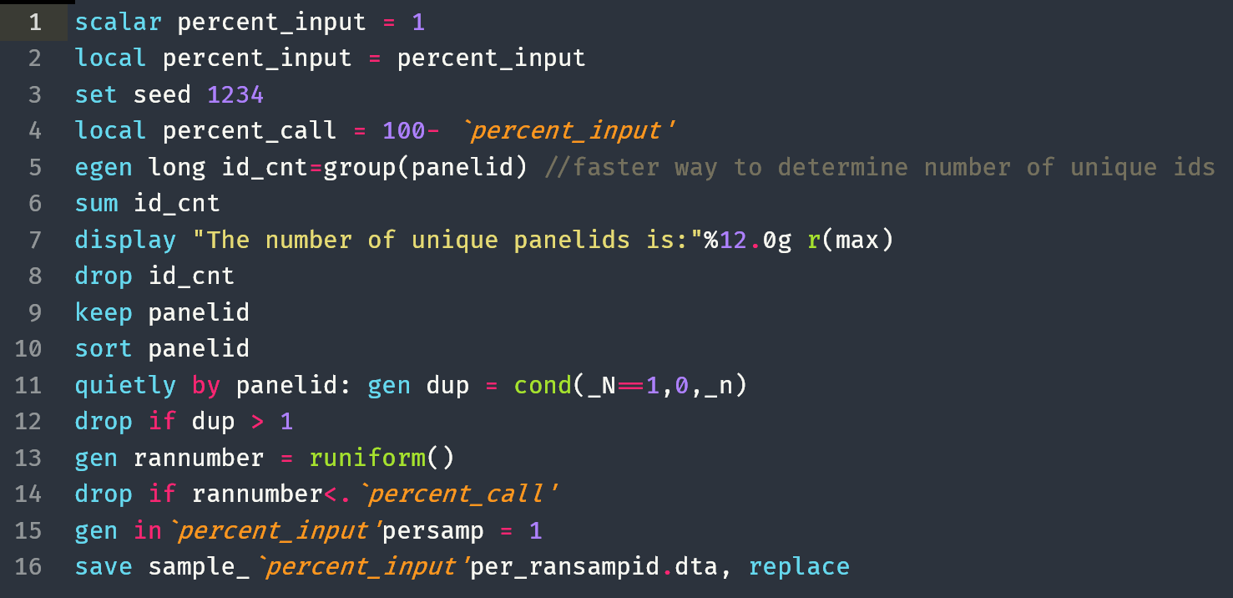
Tips and Tricks of Big Data with Stata
Write and debug programs with a 1 % random sample

Slide 12
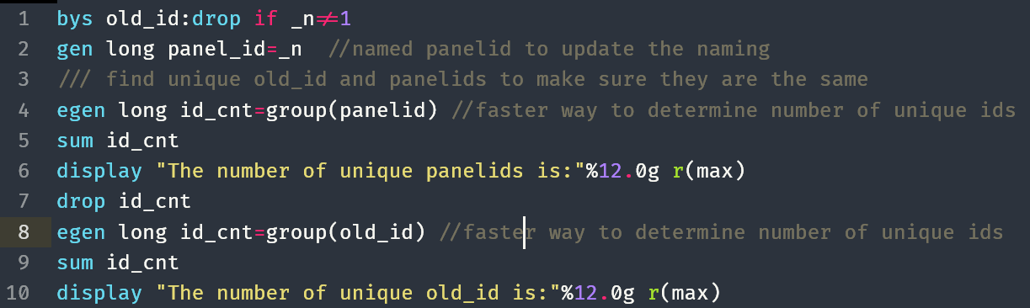
Tips and Tricks of Big Data with Stata (2)
Create your own panel identification number for each project
Use the long format to ensure no rounding errors. Important when remerging data after sets of heavy calculations.

Slide 13
Tips and Tricks of Big Data with Stata (3)
Break up the work if possible and send it to several computing nodes. Identifying if a person is dead in a quarter as the example. Start at quarter 1 for quarter 1 in year xxxx.
Problem: You must clean the data to get a random sample of people who die over time. The variables needed are panelid, dead(0,1), death_qtr(1,?), year, quarter, ever_dead(0,1), first_death. The data is too big to process at once.
Solution: Break up the work
Loop through each quarter collecting ids (recreate new panel ids shown above).
Use the centile command “ centile panelid, centile(10(10)90) to create 10 groups.
Keep only the variable necessary for the creation of death variables.
(Optional) Run each program as a separate node. (code is online)
Check that individuals listed as dead stay dead over time and drop suspicious cases from the next step.
Reassemble the data and take the project’s random sample.

Slide 14
Tips and Trick of Big Data with Stata (4)
Be ready to learn the basics of Linux for pulling up resource monitor, send email updates on your programs, and dealing with running multiple Stata sessions.
Stata’s compress command helps check variables and convert them to a space-saving format. A year as 2023.00 should be converted to an int-type variable 2023. It is time-consuming but it saves space and speeds up the loading of the data.
Stata merge can crash the Stata session with no indication in the log file. Really stinks if you have to wait in line again for an opening. Always pre-sort the data and use “,sorted” in the merge command.

Slide 15
Tips and Trick of Big Data with Stata (5)
Given big projects with several do files, start the file name with a number such as 01_data_cleaning.do, 02_sum_stats_tables_graphs.do, 03_reg_models.do, 04_final_tables_and_graphs.do. It makes collaboration and handing off work much easier for other to figure out where to start.
Use “set max_memory 128g” to prevent crashes.
Use “set min_memory 100g” to ensure other users do not take your memory and cause a crash or extreme delay. Check the size of data file to determine number.
Use “set niceness 0” to be selfish, this tells Stata not to return memory to the operating system for 30 minutes, default is one minute(niceness 5).

Slide 16
Case Study: “The Relationship between Rural Hospital Closures and Consumer Financial Debt”

Slide 17
Motivation
The rural hospital trend has continued and will likely worsen due to financial strain imposed by Covid-19
Source: Sheps Center

Slide 18
Motivation
The trend in hospital openings is not promising for rural area from 2014 through 2016 there were 3 rural hospital openings, while at the same time 42 rural hospitals closed. Urban counties had 30 hospital opening and fewer closing than rural counties (GAO, 2018)
Rural counties are much more likely be credit constrained (Hamdani et al. 2019).
Credit constrained implying residents having little to no savings and poor or no credit history in rural areas relative to urban areas.
Rural Hospitals closures have been associated with various poor outcomes, while urban hospital closures were found to be welfare improving.

Slide 19
Known Risk Factors for Hospital Closures
The literature on hospital closures had found several potential risk factors for a hospital closure. (Mullner 1986; Mobley 1994; Hansmann et al. 2003; Harrison 2007; Bertoli et al. 2017)
Operating factors:
for-profit status
operating margins
occupancy rates
low number of beds
Community characteristics:
critical access designation
local unemployment rate
low population density
number of other area hospitals
percent of Medicare patients.
The latest reason for Hospital closure has been the expansion of the Affordable Care act (Lindrooth et al. 2018). The response of rural hospitals in areas with low insurance (<10%) was particularly strong.

Slide 20
Impact of Hospital Closure
The literature on the economic impact of hospital closure has been mixed. Some papers find no impact (Hart, Pirani, and Rosenblatt 1994; Pearson 2002; Ona, Hudoyo, and Freshwater 2007). Such as per capita income, income growth rate, and unemployment rate.
Others have found an impact on per-capita income and unemployment (Probst et al. 1999; Holmes et al. 2006).
The latest attempt (Manlove and Whitacre 2017) find impacts of rural hospital closures between 2010 to 2014 on the poverty level, unemployment rate, median income, and median rent.
Rural hospital closures left most areas were left with a lower supply of physicians and in some cases, there were no physicians in the local area 2 years after the hospital closure (Hart et al. 1994)
Urban hospital closures are considered to be welfare improving ( Lindrooth et al. 2003; Capps 2010). The closures had low occupancy rate thus higher costs per adjusted admission.

Slide 21
How Hospital Closure Impact Financial Health
Direct employment, indirect employment.
Other costs of longer distance to the hospital. Such as delayed treatment, lower earnings due to missed work, higher transportation costs, value of local housing market.

Slide 22
FRBNY Consumer Credit Panel/Equifax
Years: 2000-2016
5% representative random sample of all US individual with a credit history and a social security number on file.
Contains information on different lines of credit such as
Mortgage
Auto loan and leases
Credit Cards and other revolving accounts
Data is available Quarterly
Panel data
20% random sample of the full dataset was used
No of individuals ….N*T

Slide 23
FRBNY Consumer Credit Panel/Equifax
Primary account holder
Ages 27 to 75
Observed a minimum of 4 quarters.
Final Sample Sizes of Individuals by Area Type
 | County | HSA
Total | 166,727 | 156,197
Treated | 8,332 | 6,186
Controls | 158,395 | 150,011
Source: Federal Reserve Bank of New York Consumer Credit Panel/Equifax Note: The data included primary account holders between ages 27 to 75.

Slide 24
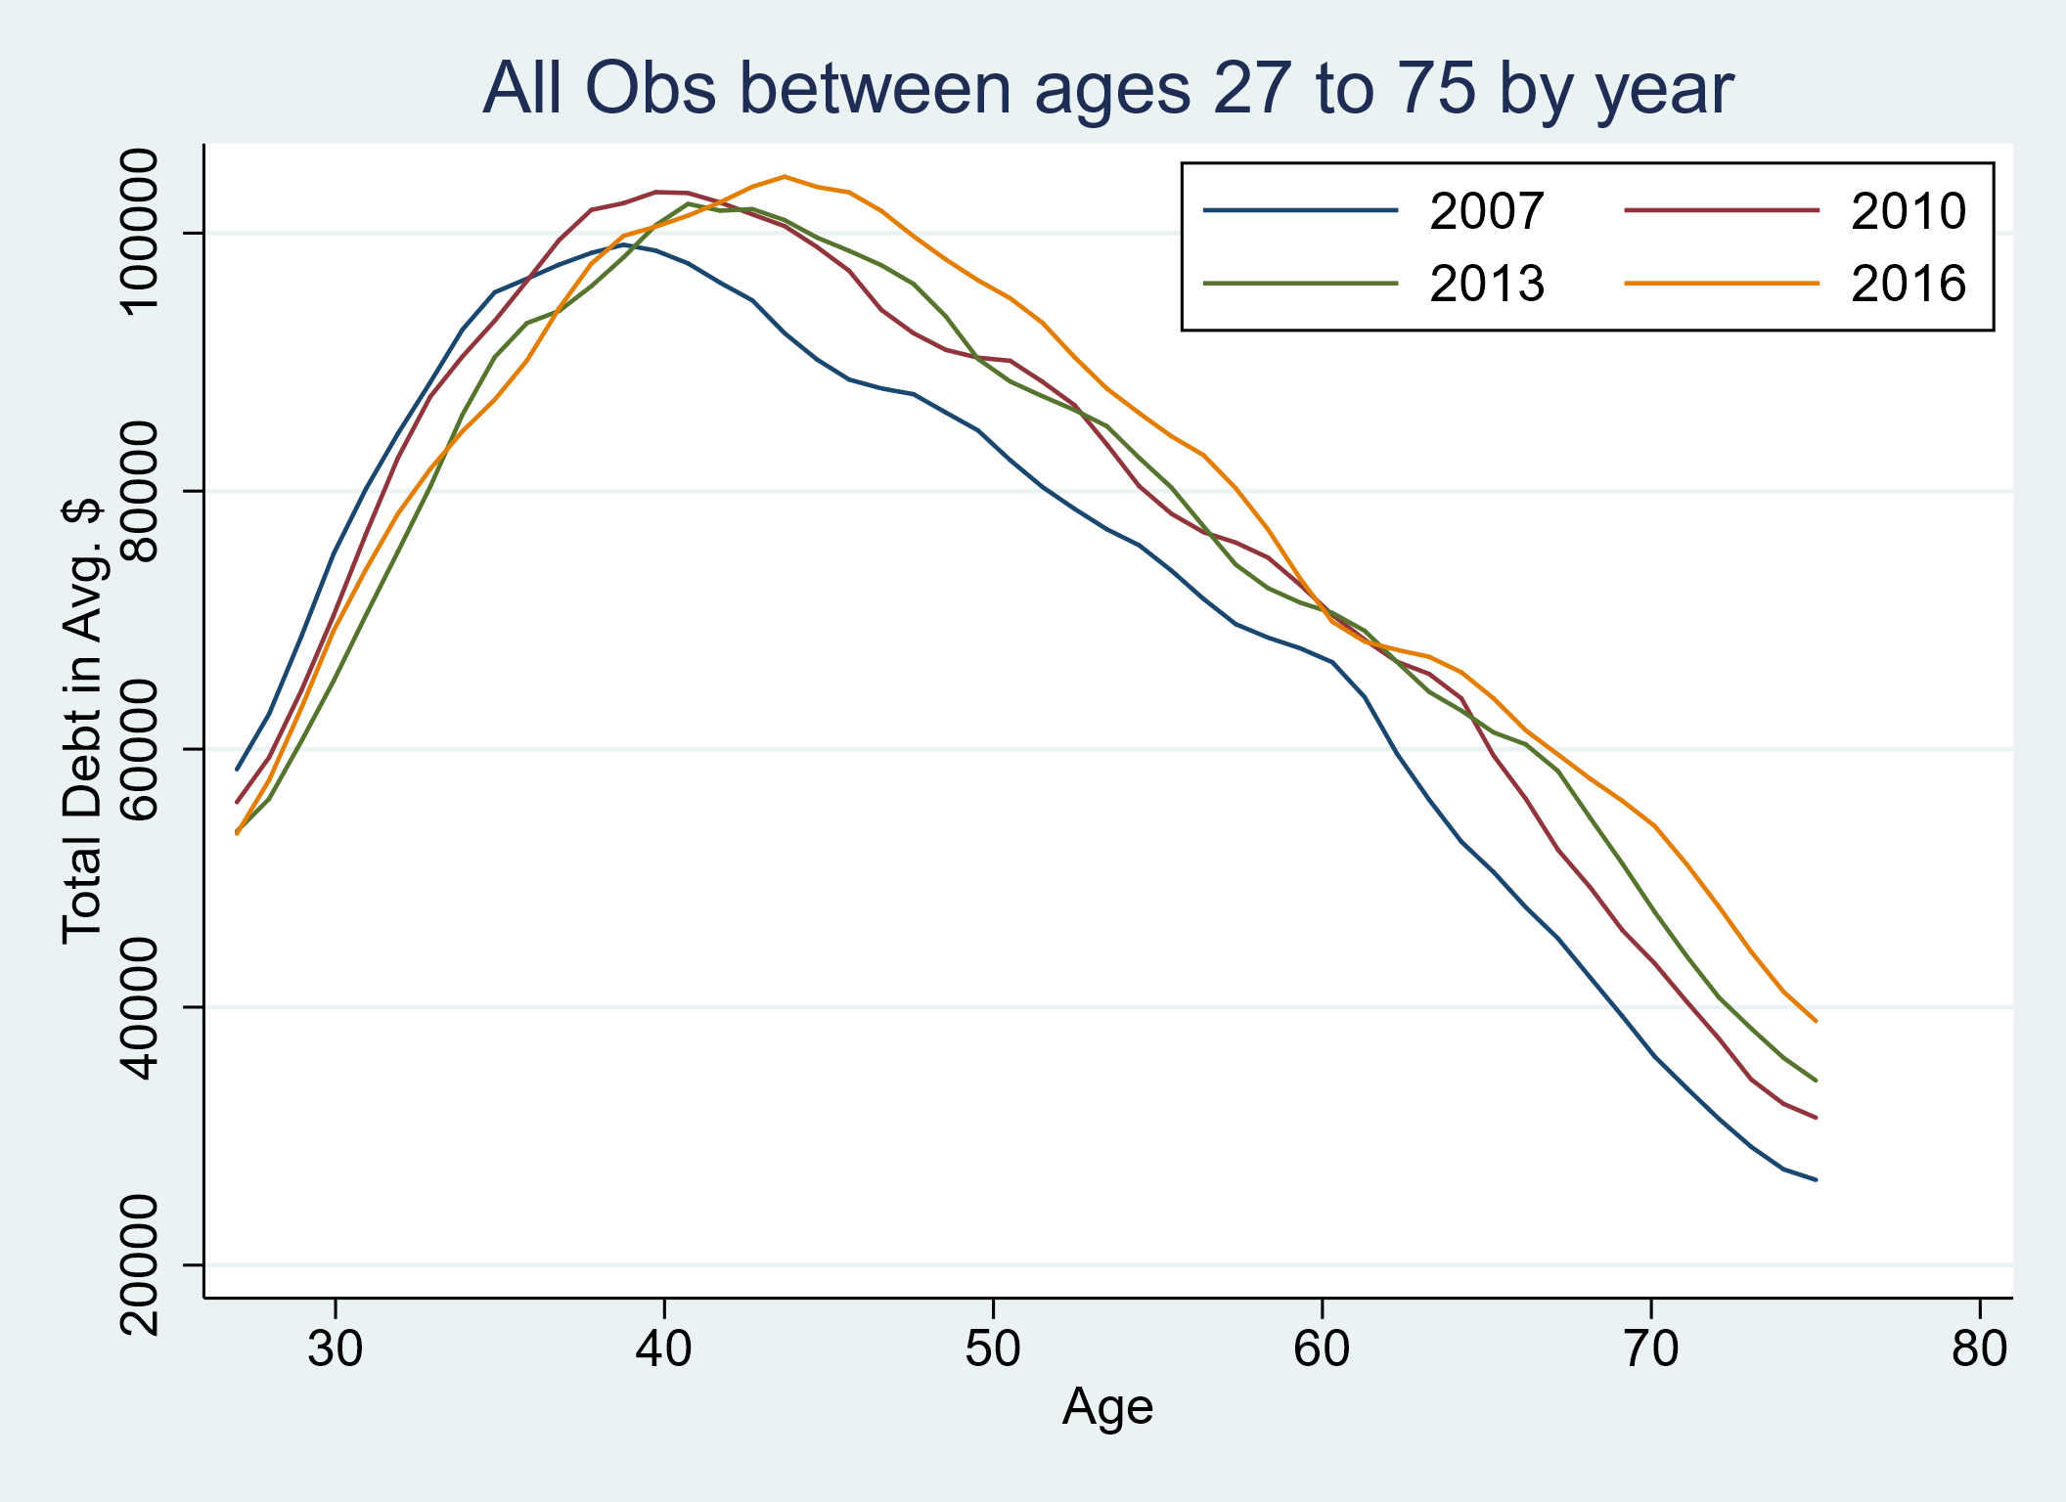
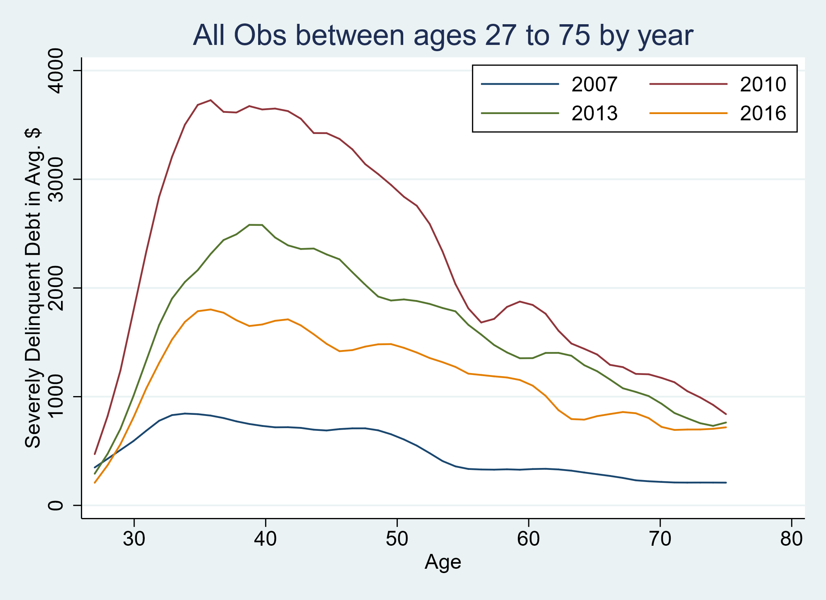
Brief Look at Financial Health Across Ages
Source: Federal Reserve Bank of New York Consumer Credit Panel/Equifax

Slide 25
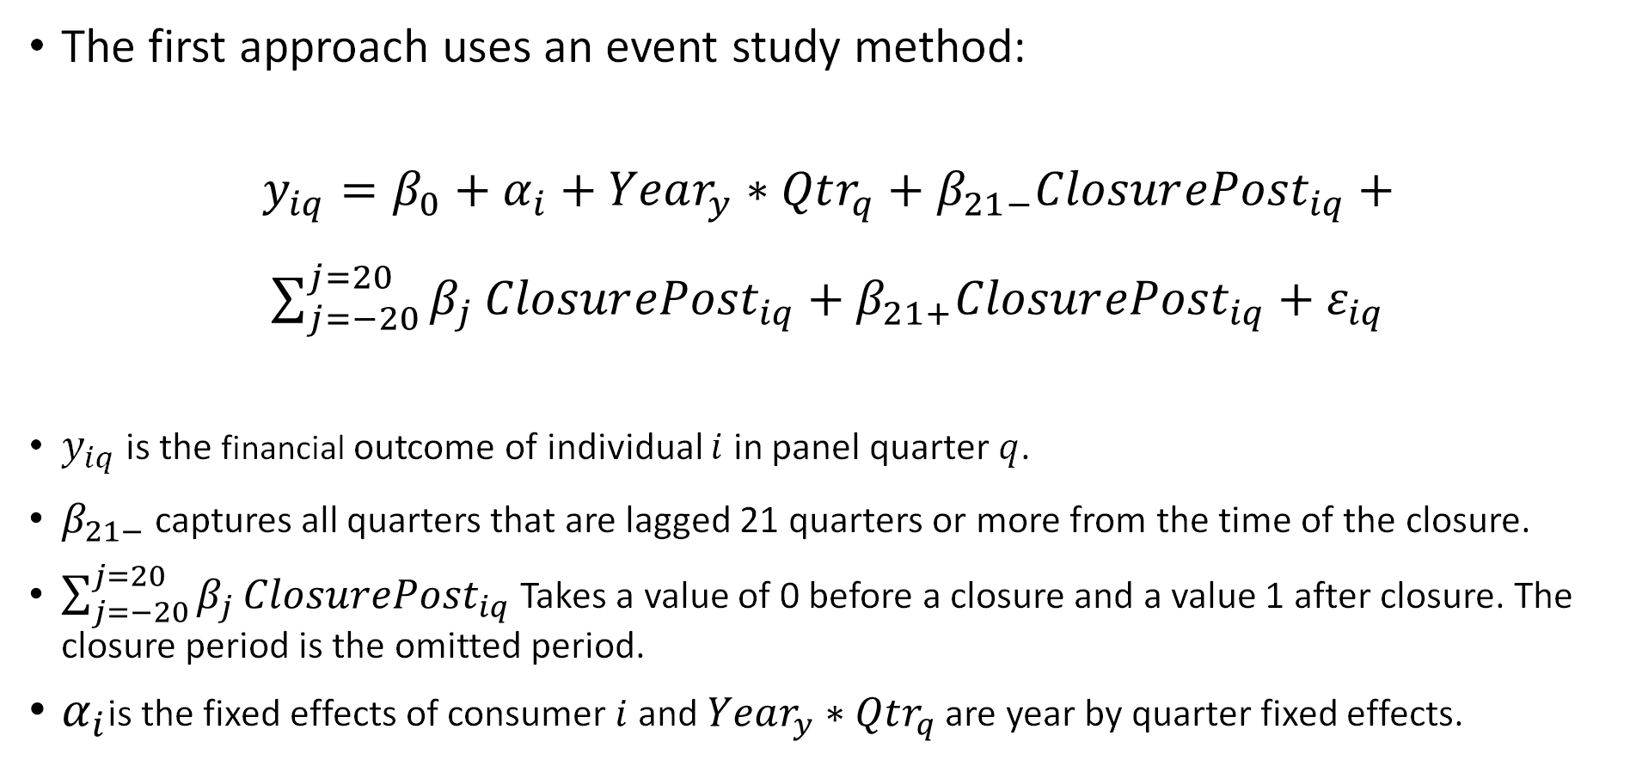
Methods
The first approach uses an event study method:
$y_{iq}=β_{0}+α_{i}+Year_{y}∗Qtr_{q}+β_{21−}Closur{ePost}_{iq}+$
$\sum_{j=−20}^{j=20}{β_{j}}Closur{ePost}_{iq}+β_{21+}Closur{ePost}_{iq}+ε_{iq}$
$y_{iq}$is the financial outcome of individual $i$ in panel quarter $q$.
$β_{21−}$ captures all quarters that are lagged 21 quarters or more from the time of the closure.
$\sum_{j=−20}^{j=20}{β_{j}}Closur{ePost}_{iq}$ Takes a value of 0 before a closure and a value 1 after closure. The closure period is the omitted period.
$α_{i}$is the fixed effects of consumer $i$ and $Year_{y}∗Qtr_{q}$ are year by quarter fixed effects.

Slide 26
Event Study for Share of Debt($) Severely Delinquent Debt at the County-Level for Ages 65 to 74

Slide 27
Table 1A: DID Treatment Effects of Hospital Closure on Severely Delinquent Debt at County-Level
Age group | Share of Accounts in SD | Share of Debt($) SD | Number of Accounts in SD | Amount of Debt($) in SD
Panel A: All Trades
All | 0.0034*** | 0.0031*** | 0.0143*** | 109.0*
 | (4.34) | (3.79) | (4.82) | (1.85)
27 to 54 | -0.0027* | -0.0020 | -0.0053 | 366.8***
 | (-1.89) | (-1.35) | (-0.91) | (3.60)
55 to 64 | -0.0011 | -0.0015 | -0.0115*** | -25.62
 | (-1.07) | (-1.41) | (-2.75) | (-0.40)
65 to 74 | -0.0010 | -0.0012 | 0.0036 | 267.4**
 | (-1.01) | (-1.11) | (1.05) | (2.04)

Slide 28
Limitations and Next Steps
Only looking at rural hospitals with an emergency room
Does not take movement of the population into consideration.
Next Steps
Include a model with movement for comparison
Expand the type of hospitals in the study to determine the value of different hospital types.

Slide 29
Conclusion
The results show that hospital closures have a significant impact on consumer finances. A closure is associated with a consumers taking on more debt and getting behind on paying down debt.
A rural hospital closure increases severely delinquent debt especially the amount severely delinquent debt mortgage debt. Revolving debt is also affected, but auto debt is not clearly affected.

